Slide 1
Maths
Unit 4 – Addition and Subtraction
WALT:
To consolidate my understanding of adding and subtracting with negative integers.

Slide 2



WALT: To consolidate my understanding of adding and subtracting with negative integers.
I can answer questions adding and subtracting negative integers.
I can answer worded questions adding and subtracting negative integers.
I can prove my answers.

Slide 3
WALT: To consolidate my understanding of adding and subtracting with negative integers.
Retrieval Practice
What is the position to term rule of this sequence?
1 | 2 | 3 | 4 | 5
3 | 5 |  |  | 11
x2 + 1

Slide 4
WALT: To consolidate my understanding of adding and subtracting with negative integers.
Starter-
TTYP - What is an integer?
A whole number that is not a fraction.
Can an integer be a negative number?

Slide 5
WALT: To consolidate my understanding of adding and subtracting with negative integers.
7 – 11 =
-3 + 8 =
-9 – 4 =
-20 + 25 =
-4
10 – 26 =
-6 + 15 =
-12 – 7 =
-4 + 12 =
-16
5
9
-13
-19
5
8

Slide 6
WALT: To consolidate my understanding of adding and subtracting with negative integers.
The temperature in London is 4°C.
Overnight it falls to -6°C.
What is the difference between the day and night temperature?
On Tuesday, the temperature is 9°C.
Overnight the temperature falls by 15°C.
What is the temperature in the morning?
10°C
-6°C

Slide 7
WALT: To consolidate my understanding of adding and subtracting with negative integers.
Ms. Colette has 550k VND in her bank account. She buys a bracelet for 835k VND.
How much money does she have in her bank account?
What is the difference between the bracelet and the amount of money she has in her bank account?
-285K VND
285K VND

Slide 8
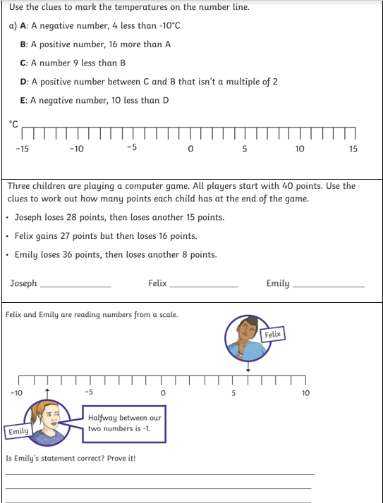
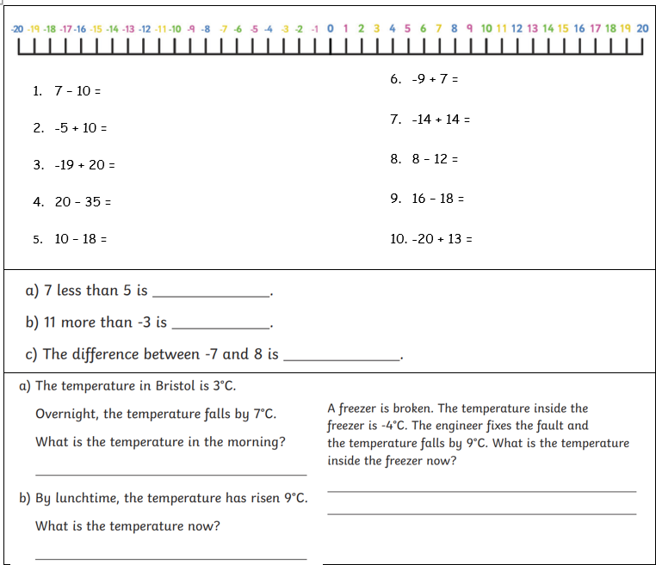
WALT: To consolidate my understanding of adding and subtracting with negative integers.
Your Task

Slide 9
WALT: To consolidate my understanding of adding and subtracting with negative integers.
I can answer questions adding and subtracting negative integers.
I can answer worded questions adding and subtracting negative integers.
I can prove my answers.

